Slide 1

The Nature of Motivation
If an employee chooses to work hard one day, and work just hard enough to avoid reprimand, or as little as possible on another day, what then is “Motivation?”
  Motivation is the set of forces that causes people to behave in certain ways.

Slide 2
The Motivational Framework
Need or
deficiency
Search for
Ways to
satisfy needs
Choice of
behavior to
satisfy need
Evaluation of
need satisfaction
Determination of
future needs and
search/choice for
satisfaction

Slide 3
The Importance of Motivation in the Workplace
What are the three factors that determine individual performance?
  Motivation: The desire to do the job.
  Ability: The capability to do the job.
  Work environment: The resources needed to do the job.

Slide 4

What Was the Traditional Approach?
Economic gain was the primary thing that motivated employees.
Money was more important to employees that the nature of the job.
Employees could be expected to perform any kind of job if they were paid.

Slide 5
What Is the Human Relations Approach?
It emphasizes the role of social processes in the workplace.
Employees want to feel useful and important.
Are these social needs more important than money?
  YES!

Slide 6
Content Perspectives on Motivation
Content perspectives are?
  Approaches to motivation that try to answer the question, ”What factors in the workplace motivate people?”
Maslow’s hierarchy of needs is?
  Physiological  Security  Belongingness Esteem  Self-actualization

Slide 7
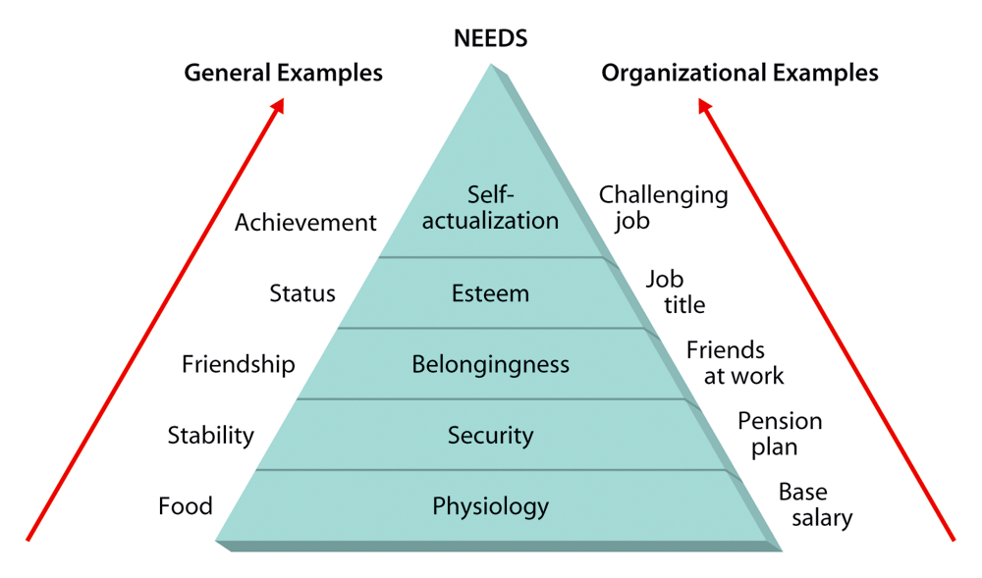
Maslow’s Hierarchy of Needs

Slide 8
The ERG Theory
Suggests that people’s needs are grouped into three possibly overlapping categories.
What are they?
  Existence.
  Relatedness.
  Growth.

Slide 9
The Two-Factor Theory
Suggests that people’s satisfaction and dissatisfaction are influenced by two independent set of factors.
Can you name them?
  Motivation factors.
  Hygiene factors.
The following is a micro view of the Two-Factor theory:

Slide 10
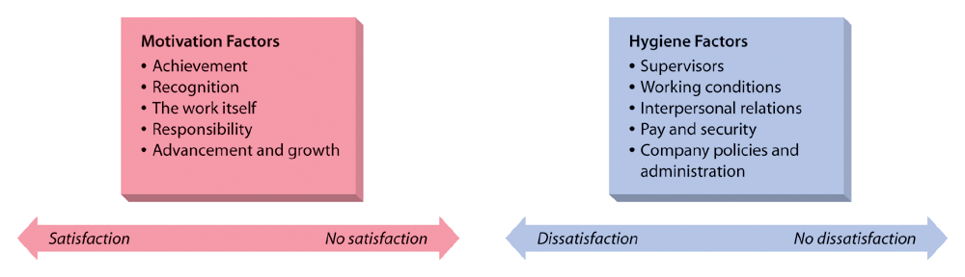
The Two-Factor Theory of Motivation

Slide 11
Micro View of the Two-Factor Theory
Motivation factors:
  Achievement
  Recognition
  The work itself
  Responsibility
  Advancement and growth
Hygiene factors:
  Supervisors
  Working conditions
  Interpersonal relations
  Pay and security
  Company policies and administration

Slide 12
What Are the Individual Human Needs?
Need for achievement:
  The desire to accomplish a goal or task more effectively than in the past.
Need for affiliation:
  The desire for human companionship and acceptance.
Need for power:
  The desire to be influential in a group and to control one’s environment.

Slide 13
Process Perspectives on Motivation
How does motivation occur?
  Process perspectives:
    Approaches to motivation that focus on why people choose certain behavioral options to satisfy their needs and how they evaluate their satisfaction after they have attained these goals.

Slide 14
Expectancy Theory
Suggests that motivation depends on two factors.
What are the two factors?
  How much we want something.
  How likely we think we are to get it.

Slide 15
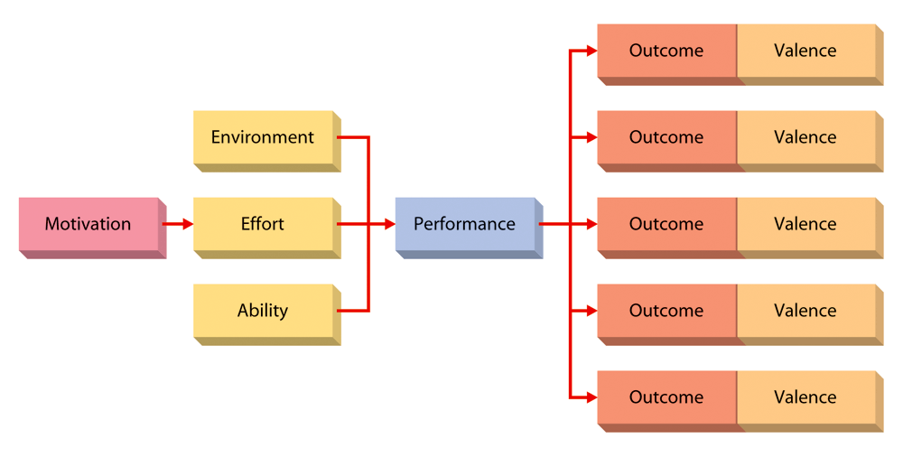
The Expectancy Model of Motivation

Slide 16

The Equity Theory
What is it?
  Suggests that people are motivated to seek social equity in the rewards they receive for performance.
Porter-Lawler Extension theory:
  Suggests that if performance results in equitable rewards, people will be more satisfied. Thus, performance can lead to satisfaction.

Slide 17
Goal-Setting Theory
Goal difficulty:
  The extent to which a goal is challenging and requires effort.
Goal specificity:
  The clarity and precision of the goal.

Slide 18
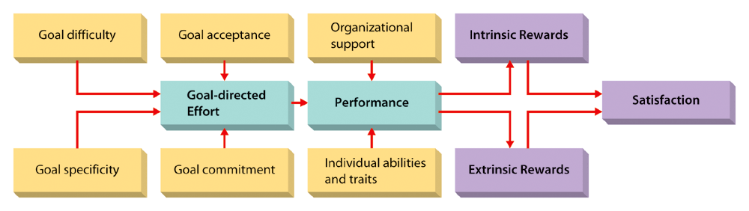
The Expanded Goal-Setting Theory of Motivation

Slide 19

Elements of Reinforcement Theory
Arrangement of the reinforcement contingencies:
  Positive reinforcement.
  Avoidance.
  Punishment.
  Extinction.
Schedules for applying reinforcement:
  Fixed interval.
  Variable interval.
  Fixed ratio.
  Variable ratio.

Slide 20
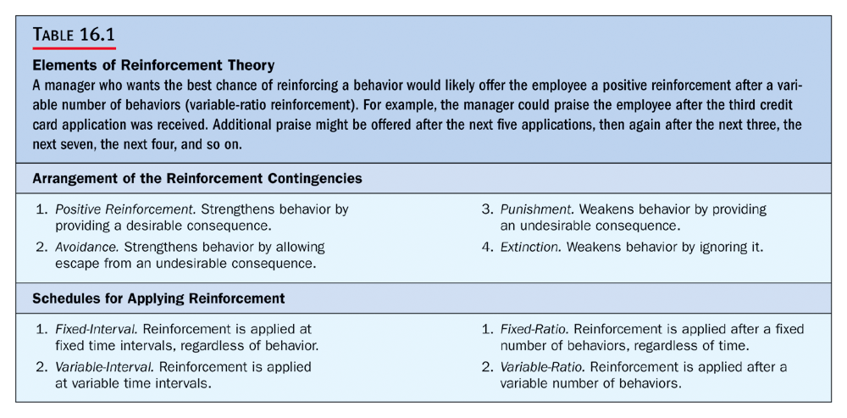

Slide 21
Popular Motivational Strategies
Empowerment:
  The process of enabling workers to set their own work goals, make decisions, and solve problems within their sphere of responsibility and authority.
Participation:
  The process of giving employees a voice in making decisions about their own work.
New Forms of Working Arrangements:
  Flexible work schedules.
  Job sharing.
  Compressed work schedules.
  Telecommuting.

Slide 22

Reward Systems
Reward system:
  The formal and informal mechanism by which employee performance is defined, evaluated, and rewarded.
Merit system:
  A reward system whereby people get different pay raises at the end of the year depending on their overall job performance.
Incentive system:
  A reward system whereby people get different pay amounts at each pay period in proportion to what they do.

